Slide 1
Quantum-Assisted Optimization Engine for CXL-Aware Hybrid Scheduling

Slide 2
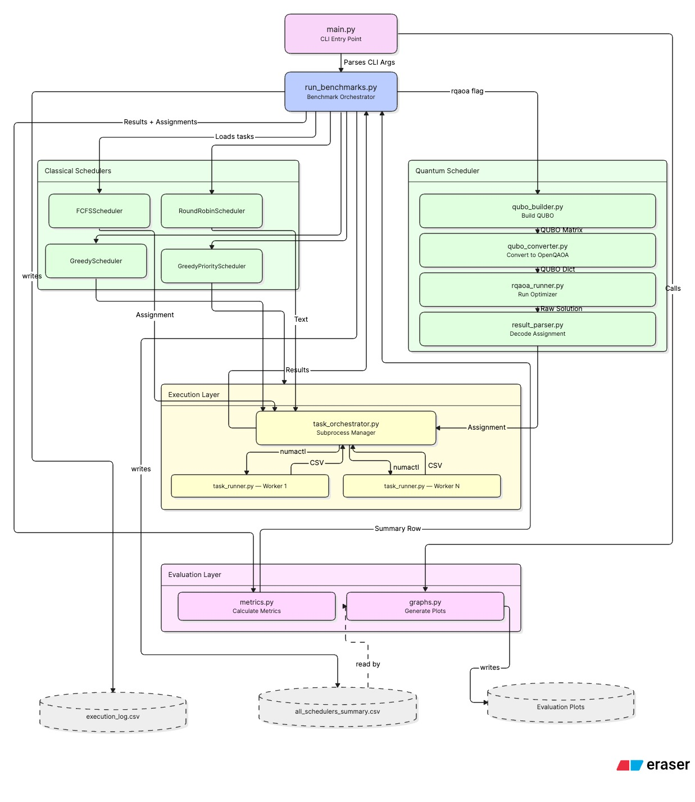
System Architecture
Tasks → Scheduler (Classical / RQAOA) → Assignment → Execution Layer → execution_log.csv → Evaluation → Results

Slide 3
main.py — Entry Point
CLI Trigger
$ python main.py --scheduler rqaoa
# entry point — starts entire workflow
run_benchmarks()
# loads tasks, calls scheduler
# executes workloads
# collects results
generate_all_plots()
# auto-creates all eval graphs
Execution starts from main.py. Run with any supported --scheduler flag.
run_benchmarks()
Loads tasks, invokes the selected scheduler, executes workloads, collects runtime statistics, and generates final results.
generate_all_plots()
Automatically creates every evaluation graph used for benchmarking and performance analysis.
main.py is the single entry point that ties the entire framework together — from task loading through scheduling, execution, and result generation.

Slide 4
Benchmark Pipeline — Project Coordinator
①
Load Tasks
②
Invoke Scheduler
③
Receive Assignment
Read task set with memory requirements, priorities, and sensitivity values
Classical (FCFS / RR / Greedy) or Quantum (RQAOA)
DRAM-CXL placement decision for every task
④
Trigger Execution
⑤
Collect Statistics
⑥
Generate Results
Execution layer enforces assignments and runs workloads
Runtime logs captured from each worker process
metrics.py + graphs.py produce final evaluation
The benchmark pipeline connects optimization → execution → evaluation into one complete workflow

Slide 5
Scheduler Output → Execution Layer
Memory Assignment Output
Enforces Placement
Task 0
→
DRAM
Each task runs in its assigned memory tier (DRAM or CXL)
Task 1
→
CXL
Runs Workloads
Workers execute tasks and measure runtime for each assignment
Task 2
→
DRAM
▶
Collects Runtime Stats
Task 3
→
CXL
Execution time, start/end timestamps, and latency recorded per task
Task N
→
DRAM
Writes execution_log.csv
The bridge between execution results and evaluation metrics

Slide 6
Execution Logs — execution_log.csv
Scheduler
Task ID
Memory Tier
Duration
Start
End
Latency Cost (ns)
RQAOA
0
DRAM
0.043s
0.001s
0.044s
~46,080
RQAOA
1
CXL
0.198s
0.044s
0.242s
~218,880
FCFS
0
DRAM
0.041s
0.000s
0.041s
~44,160
FCFS
1
CXL
0.201s
0.041s
0.242s
~221,440
DRAM Assignment
DRAM Assignment
CXL Assignment
~46,080 ns — fast memory tier, low access cost
~46,080 ns latency — fast memory tier, low access cost
~218,880 ns latency — slower tier, higher access cost
execution_log.csv = bridge between execution and evaluation — the execution layer writes it; the evaluation layer reads it to produce metrics and graphs

Slide 7
Latency Cost Calculation
Latency Cost ≈ Memory Size × Sensitivity × Tier Latency
Memory Requirement
Memory Sensitivity
Tier Latency
Size of memory the task needs to execute. Larger tasks have higher base cost.
How much performance suffers if placed in a slower tier. High-sensitivity tasks receive a larger penalty in CXL.
DRAM: ~80–100 ns (fast) CXL: ~300–400 ns (3–5× slower) Placement in CXL always costs more.
Scheduler Objective
Minimize total latency cost across all tasks while respecting DRAM capacity constraints. Both classical schedulers and RQAOA optimize for this same objective.

Slide 8
Complete Workflow — Recap
main.py
Benchmark Pipeline
Scheduler
Execution Layer
Logs
Evaluation Layer
→
→
→
→
→
CLI Entry Point
Central Controller
Classical / RQAOA
Enforce + Run
execution_log.csv
Metrics + Graphs
• main.py starts execution via run_benchmarks()
• Benchmark pipeline coordinates all modules end-to-end
• Scheduler (Classical or RQAOA) generates DRAM-CXL placement decisions
• Execution layer enforces those decisions, runs workloads, and writes execution_log.csv
• Evaluation layer reads the log and produces metrics and performance graphs

Slide 9
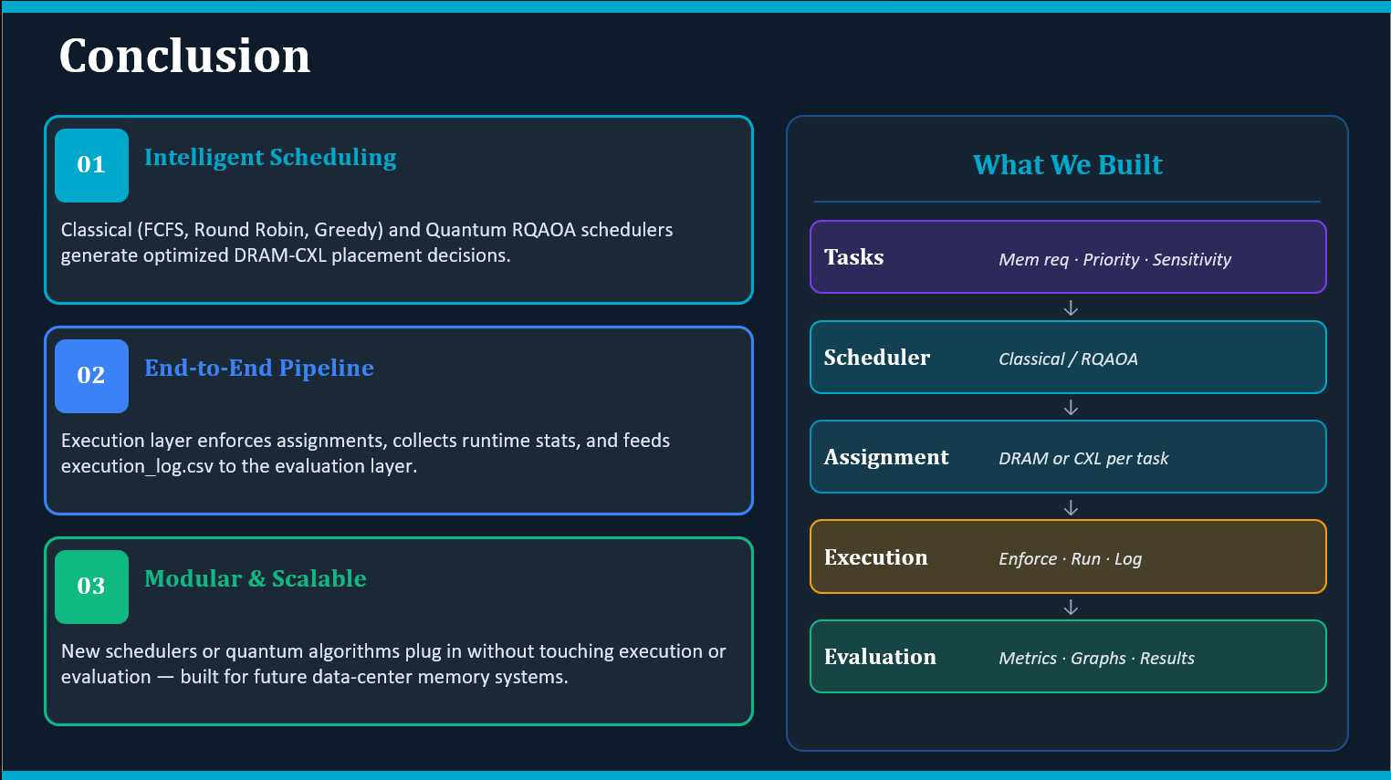
Conclusion
01 Intelligent Scheduling
02 End-to-End Pipeline
03 Modular & Scalable
Classical (FCFS, Round Robin, Greedy) and Quantum RQAOA schedulers generate optimized DRAM-CXL placement decisions.
Execution layer enforces assignments, collects runtime stats, and feeds execution_log.csv to the evaluation layer for metrics and graphs.
New schedulers or quantum algorithms plug in without touching execution or evaluation — built for future data-center memory management.
What We Built
Tasks
Mem req · Priority · Sensitivity
↓
Scheduler
Classical / RQAOA
↓
Assignment
DRAM or CXL per task
↓
Execution
Enforce · Run · Log
↓
Evaluation
Metrics · Graphs · Results

